Slide 1
Artificial Intelligence
Unlock the Potential of AI
www.freeaitools.online

Slide 2
01. Introduction to Artificial Intelligence
02. Types of Artificial Intelligence
03. Applications of AI
04. Advancement in AI
05. Ethics and Impact of AI

Slide 3
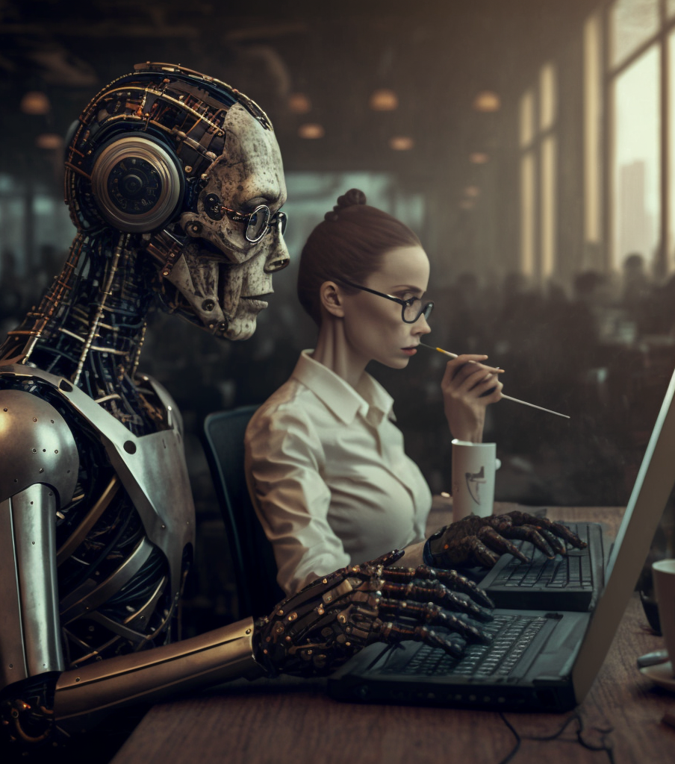
Definition and History of AI
Artificial Intelligence (AI) is the simulation of human intelligence in machines that are programmed to think and learn like humans.
It involves the development of algorithms and computer programs that can perform tasks that would normally require human intelligence, such as understanding natural language, recognizing images, making decisions, and solving problems.

Slide 4
The concept of AI can be traced back to ancient Greek myths and stories of automatons, but it wasn't until the 1950s that the field of AI began to take shape.
Researchers such as Alan Turing and John McCarthy laid the foundations for AI, and in 1956, the Dartmouth Conference marked the official birth of AI as a field of study. Since then, AI has made significant progress in the areas of machine learning, natural language processing, and computer vision.

Slide 5
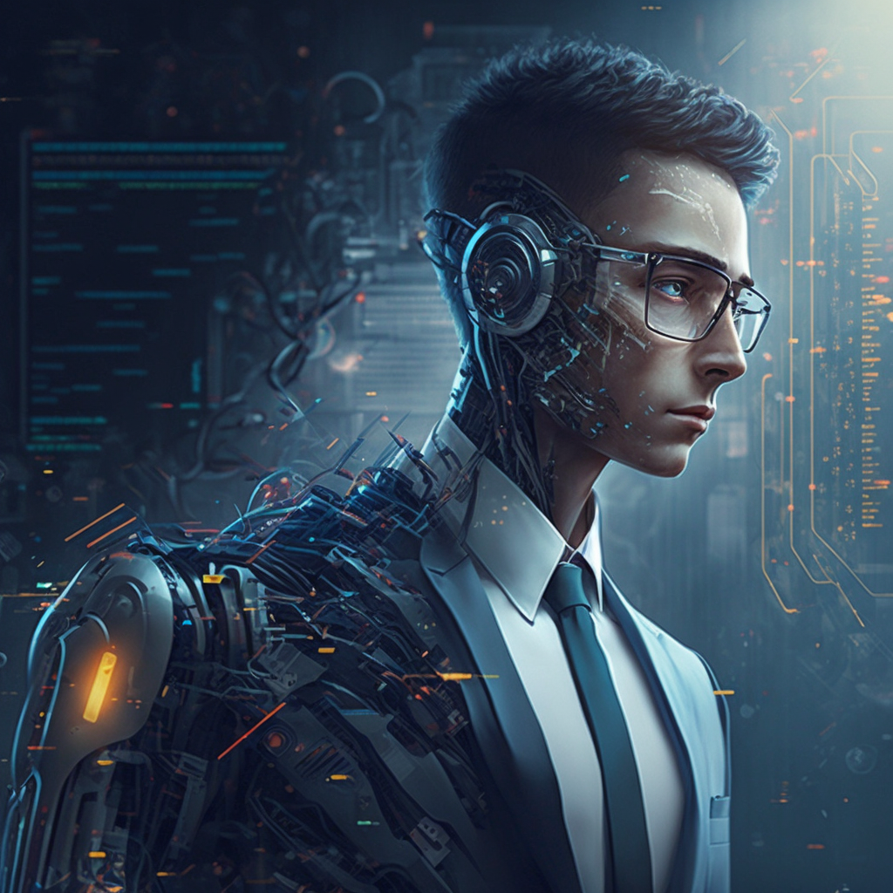
The Current State of AI Development
Today, AI has become an integral part of our daily lives.
It is being used in a wide range of applications, including self-driving cars, personal assistants like Siri and Alexa, and in healthcare to analyze medical images.
The development of AI is also being driven by the availability of large amounts of data, powerful computing resources, and advancements in neural networks.

Slide 6
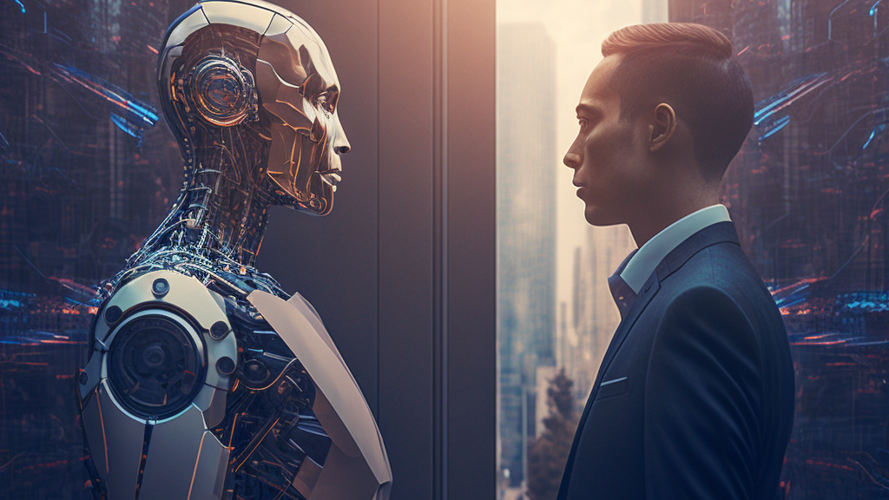
Types of Artificial Intelligence

Slide 7
Reactive Machines
Limited Memory
This type of AI is the most basic form, and it only reacts to the environment and does not have the ability to remember past experiences or use them to inform future decisions. Examples include IBM's Deep Blue chess-playing computer and Google's AlphaGo
This type of AI can remember past experiences and use them to inform future decisions, but it can only remember a limited amount of information. Examples include self-driving cars that can remember past traffic patterns and use them to make decisions on how to navigate the roads.
Theory of Mind
Self-Aware
This type of AI can understand and reason about mental states, such as beliefs and intentions. This is still a largely theoretical area of AI research and there are no current examples of this type of AI.
This type of AI can understand its own mental states and consciousness. There are currently no examples of this type of AI in existence.

Slide 8

Applications of AI

Slide 9
Applications of AI
Robotics
Gaming
Robots powered by AI are used in a wide range of industries, including manufacturing, healthcare, and transportation. They can perform tasks that are dangerous or difficult for humans, such as working in hazardous environments or performing complex surgeries
AI is used to power intelligent game opponents and to analyze player behavior and preferences.
Healthcare
Finance
AI is used for applications such as image analysis, drug discovery, and precision medicine.
AI is used in finance for applications such as fraud detection, risk assessment, and portfolio management.
Computer Vision
Natural Language Processing
AI-powered computer vision systems are used to analyze and understand images and videos. They are used in a wide range of applications, including self-driving cars, security systems, and medical imaging.
AI-powered natural language processing (NLP) systems are used to analyze, understand, and generate human language. They are used in various applications, including chatbots, language translation, and sentiment analysis.

Slide 10

Advancement of AI

Slide 11

Applications of AI
Reinforcement Learning
Reinforcement learning is a type of ML where an agent learns by interacting with its environment and receiving feedback in the form of rewards or penalties. It has been used to train agents to play games, control robots, and make decisions in dynamic environments.
Neural Networks
Neural networks are a type of machine learning model inspired by the structure and function of the human brain. They consist of layers of interconnected nodes, called neurons, that process and transmit information. Neural networks have been used to achieve state-of-the-art results in a wide range of applications, including image recognition, natural language processing, and game-playing.

Slide 12

Applications of AI
Machine Learning
Machine learning (ML) is a method of teaching computers to learn from data, without being explicitly programmed. It involves the use of algorithms that can find patterns in data and make predictions or decisions.
Deep Learning
Deep learning is a subfield of ML that involves the use of neural networks with multiple layers. These deep neural networks are able to learn complex representations of data and have achieved state-of-the-art results in a wide range of applications, such as image and speech recognition.

Slide 13

Ethics and Impact of AI

Slide 14
Ethics and Impact of AI
Job Displacement
As AI becomes more advanced, it may replace human workers in certain industries, leading to job displacement. This could have a significant impact on the economy and society.
Bias and Fairness
AI systems can perpetuate and even amplify existing societal biases, leading to unfair outcomes. This is an essential area of research, and efforts are being made to develop methods for detecting and mitigating bias in AI systems.
Privacy and Security
As AI systems collect and analyze large amounts of personal data, there are concerns about privacy and security. It's important to ensure that personal data is protected and that AI systems are secure against malicious attacks.
Transparency and Explainability
AI systems can be complex and difficult to understand, making it hard to explain how they arrived at a particular decision. This is an important area of research and efforts are being made to develop methods for making AI systems more transparent and explainable.

Slide 15
Conclusions
Summary of key points
Artificial Intelligence (AI) is the simulation of human intelligence in machines that are programmed to think and learn like humans. It involves the development of algorithms and computer programs that can perform tasks that would normally require human intelligence, such as understanding natural language, recognizing images, making decisions, and solving problems.
The future potential of AI
The future potential of AI is vast, and it is likely to play an increasingly important role in our lives. It has the potential to revolutionize industries, improve healthcare, and make our lives easier and more efficient.
Importance of responsible development and use of AI
As with any powerful technology, it is important to ensure that AI is developed and used responsibly, with consideration for its potential impact on society and the economy. This includes addressing ethical concerns such as bias and job displacement and ensuring the privacy and security of personal data.

Slide 16

Thank you
“It’s going to be interesting to see how society deals with artificial intelligence, but it will definitely be cool.”
Colin Angle
CEO at iRobot

